Slide 1


Ahad Momin,
Ayah Alomari
Mentor: Nazmus Sakib
Project: Estimating Polarity-Based Distribution of Bitumen by Simplified Chromatographic Techniques

Slide 2
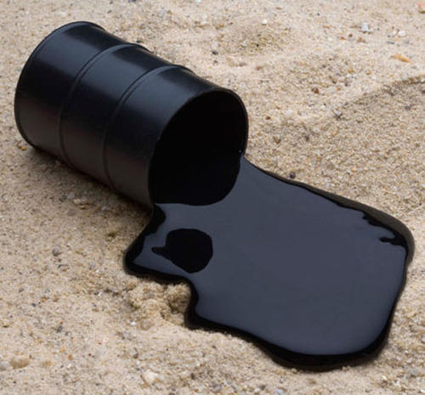
Bitumen
Black thick viscous liquid that is obtained from petroleum distillation or naturally from subsurface

Slide 3
Bitumen
Asphaltene
Maltene
Saturates
Aromatics
Resins

Slide 4
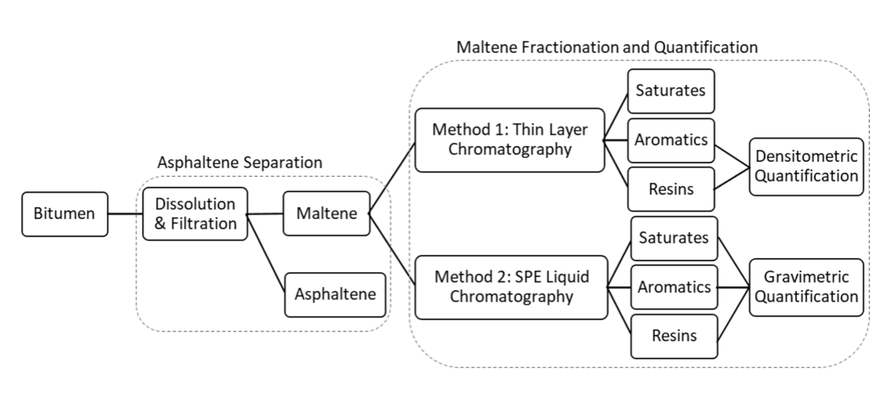
Outline/Goal:
Step 1
Step 2
Silica Based Solid Phase Extraction (SPE)

Slide 5
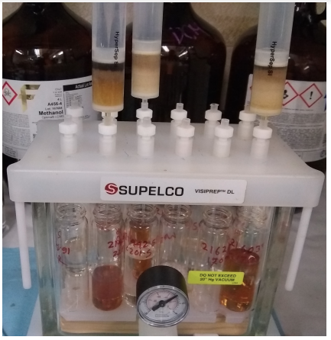
The Job
Reduce time and operation costs of Bitumen separation process
Increase repeatability of testing with reducing bias
Compare results with historical and existing methods to verify
Observe the effect of bitumen aging and blending

Slide 6
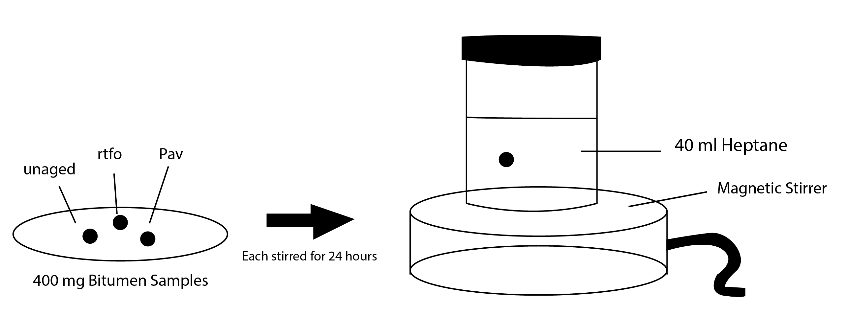
STEP 1: Asphaltene Filteration
400 mg of 3 different category Bitumen samples are diluted with 40ml of heptane and stirred for 24 hours

Slide 7
The syringes are mounted on the 12 port vacuum manifold and above the filters
The solution is poured down into the syringe which goes through the filters
The 0.2-0.22 µm filters collects Asphaltene and Maltene is extracted into the vials
The process of filtration is increased by applying a vacuum

Slide 8
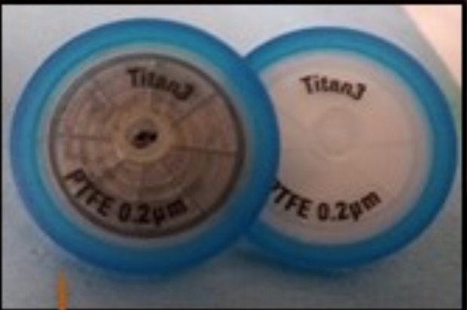
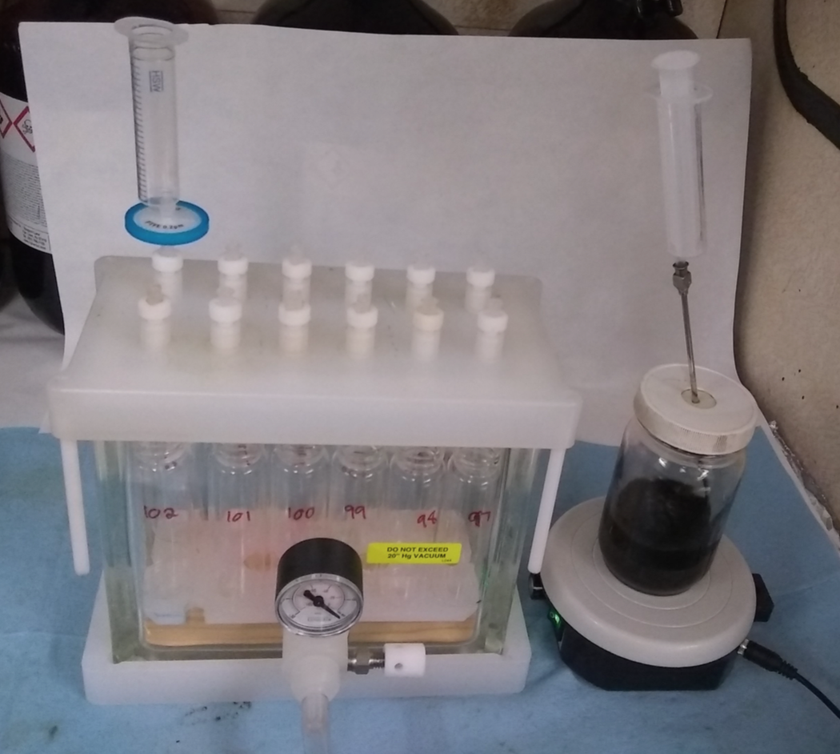
syringe
Filter
Vacuum Manifold
Bitumen Mixed with Heptane

Slide 9
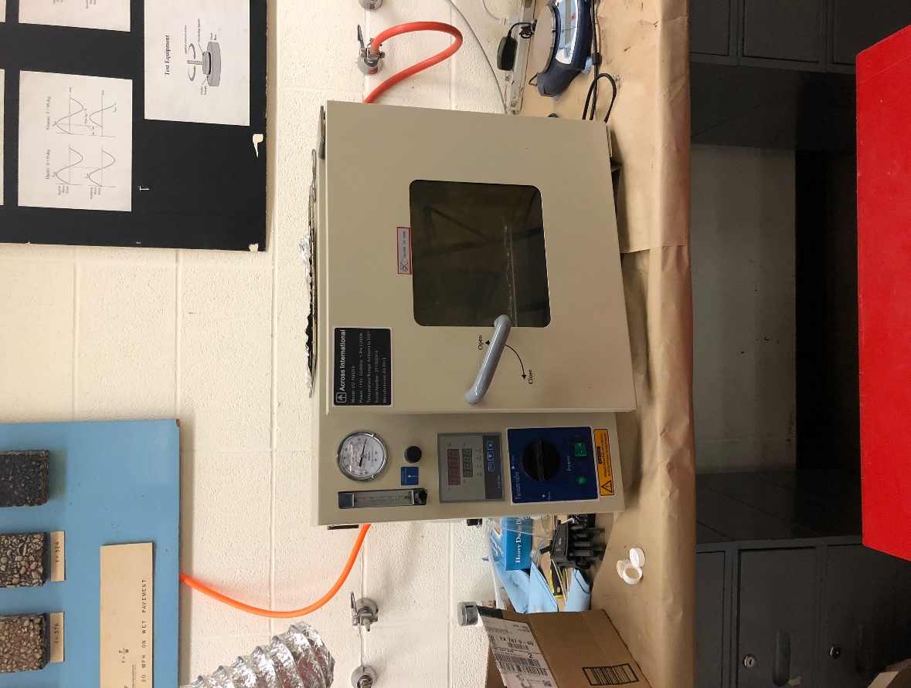
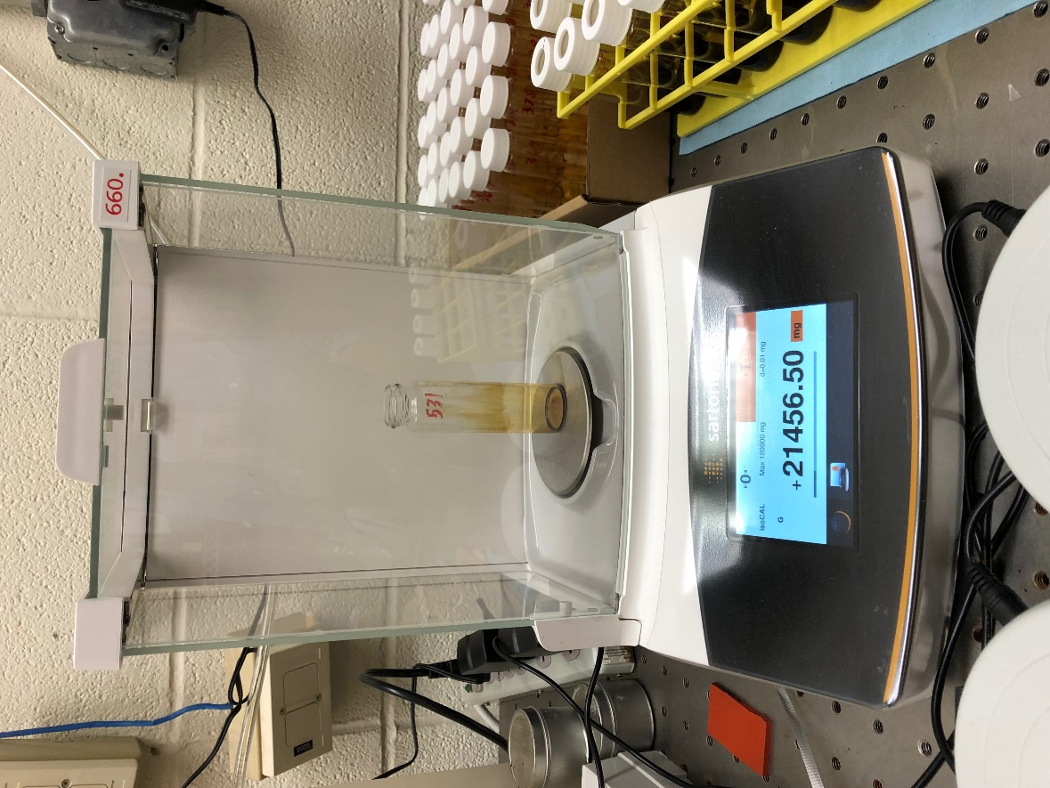
Maltene is dried in the oven and weighted to measure Asphaltene content
The extracted Maltene is used in fractionation process to separate into SARA

Slide 10
STEP 2: Maltene Fractionation
Maltene extracted from asphaltene filtration is poured into the mounted Silica based Solid Phase Extraction (SPE) cartridges on vacuum manifold
50 mg of Maltene is separated in Saturates, Aromatics and Resins
Prewash and three elution steps are used to separate Maltene into SARA

Slide 11
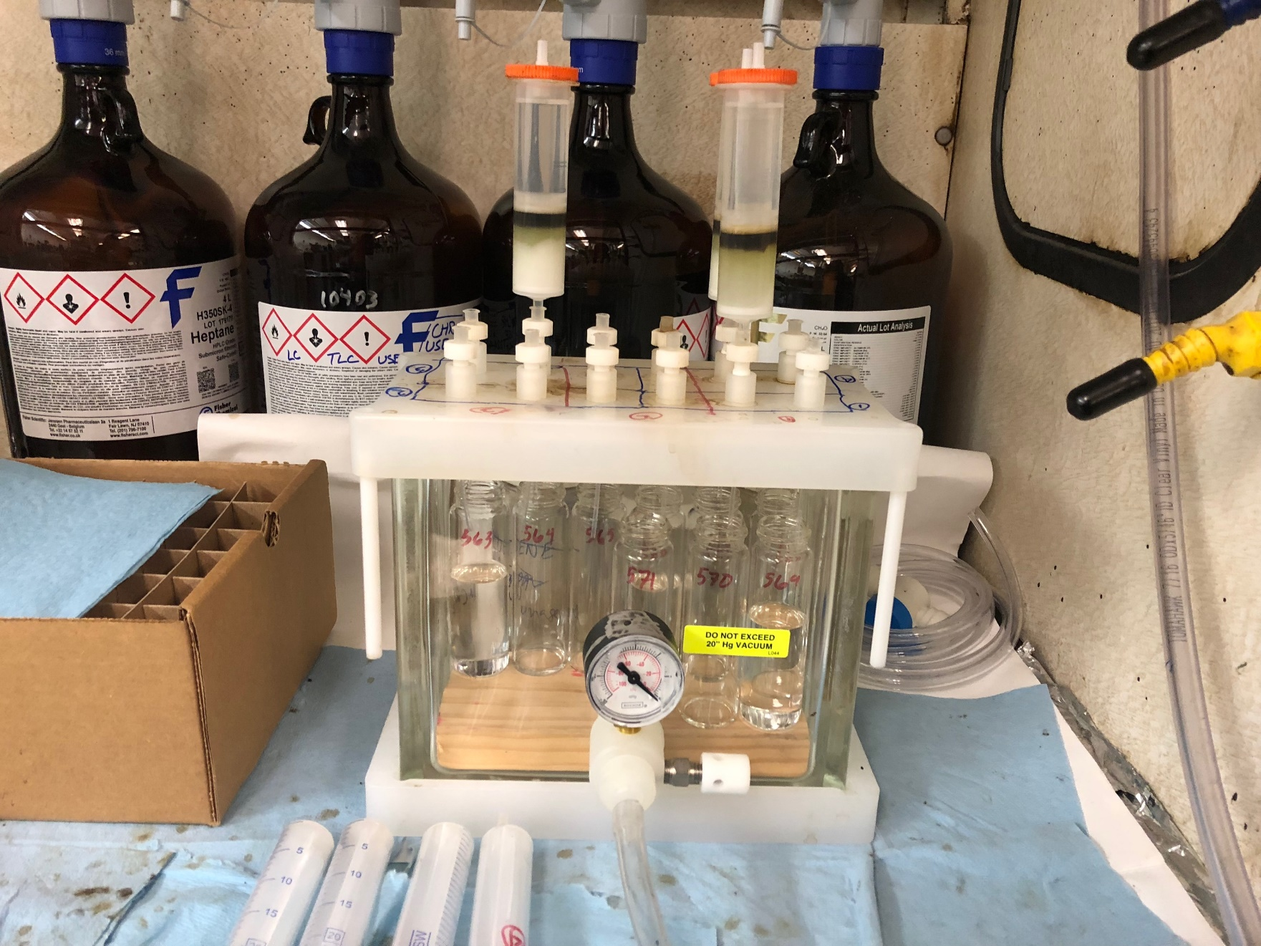
SPE cartridges
Vacuum
Manifold

Slide 12
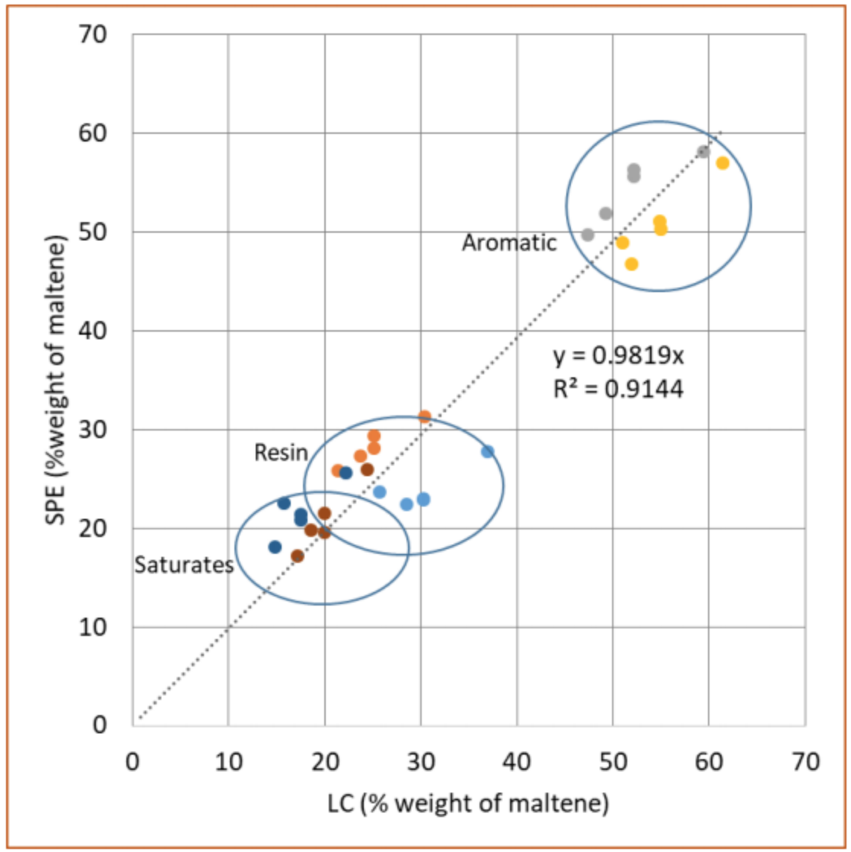
Data Obtained
Batch no | Bitumen Samples | Bottle no. | Sample no | Weight
10281 | unaged | 1 | 1 | 400.22
10281 | unaged | 2 | 2 | 410.32
10281 | rtfo | 3 | 1 | 408.71
10281 | rtfo | 4 | 2 | 413.32
10281 | pav | 5 | 1 | 420.52
10281 | pav | 6 | 2 | 411.74
Binder | Effect of ageing | Maltene (mg) | SAR | SAR of binder
10281 | unaged | 75.02 | Saturate | 17.77
 |  |  | Aromatics | 20.40
 |  |  | Resins | 36.86
10281 | unaged | 74.24 | Saturate | 12.38
 |  |  | Aromatics | 42.08
 |  |  | Resins | 19.78
10281 | rtfo | 76.74 | Saturate | 22.03
 |  |  | Aromatics | 37.80
 |  |  | Resins | 16.91
10281 | rtfo | 76.33 | Saturate | 27.17
 |  |  | Aromatics | 28.68
 |  |  | Resins | 20.48
10281 | pav | 70.72 | Saturate | 17.59
 |  |  | Aromatics | 33.12
 |  |  | Resins | 20.01
10281 | pav | 65.19 | Saturate | 18.77
 |  |  | Aromatics | 30.52
 |  |  | Resins | 15.90

Slide 13
Discussion
The results obtained are close to values from existing standards
The process is repeatable and shows clear effect of ageing
This proves that the SPE chromatography method is cost efficient

Slide 14
Future Work
No thank you

Slide 15
Questions ?

